Slide 1
OUTLOOK VIETNAM ECONOMY 2021-2022 Recovery, opportunities and risks
“Finance for recovery and sustainable development”
Hanoi, Nov 5, 2021

Slide 2
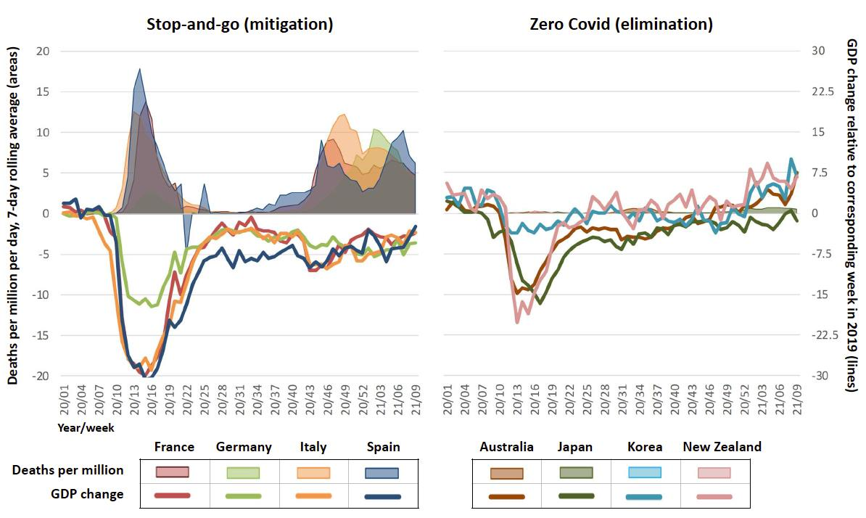
https://voxeu.org/article/aiming-zero-covid-19-ensure-economic-growth?fbclid=IwAR0DdABp4RfWnwymLeNArRZMvDKOVl6unEe8PnMPmfWenvMPvaFHGa4WS1M
Aiming for zero Covid-19 to ensure economic growth
(Philippe Aghion, Patrick Artus, Miquel Oliu-Barton, Bary Pradelski 31 March 2021)

Slide 3
How has the COVID-19 affected Vietnam’s economy?
Actual and potential growth

Slide 4
How COVID-19 affected Vietnam’s economy?

Slide 5
Contribution of labor productivity on growth decline

Slide 6
Opportunities and risks, challenges
Opportunities
Risks and challenges
The world economy recovery
Fast growth in FDI recovery
FTAs come into effect
Change approach on Covid-19 control measures
Price jumping
Logistics costs and reshape supply chains
Shifting domestic capital flows
Bad debt risk
State budget
Labor recovery

Slide 7
Impacts of world prices
World price forecast
Impact on Vietnam’s inflation

Slide 8
Impact of high logistics costs
Impact on GVC
COVID19 create new bottlenecks in supply chain in some main points such as Taiwan, China, and Malaysia (semiconductor)
Restructuring motivation caused by the pandemic even higher than pressure from increase tariff due to US-China trade war.

Slide 9
Impact of global economic stimulus and support packages
The US’s $1.900 bil. (3/2021): support for local governments, cash assistance to households, spending on education, health care, unemployment insurance, and credit assistance (loans and grants) to affected SMEs
EU’s €750 billion (12/2020), grants (€390 billion) and loans (€360 billion) 2021-23, of which 70% will be in 2021-22.
Japan’s $708 billion stimulus package, 13.1% GDP (12/20), support enterprises digitization and green technology as well as expanding COVID-19 preventing measures, providing preferential credit to affected businesses

Slide 10
Impact of FTAs
Negative
Positive
EVFTA, estimate Vietnam GDP could increase by 0.28% to 0.63% per year in short term, from 1.24% to 2.02% per year in medium term (current assessment)
Export increase by 0,66%-1,14% per year in short term in the period 2019-2021; 3.15%-5.13% per year in the period 2022-2024
RCEP alsoe increase Vietnam by 0.38% and 3,75%
CPTPP: Although the impact through tariffs is not much, the impact of institutional reform is very large
Increase export?
Which way to shift chain?
FTA is tool, but how to use tool depend on internal force

Slide 11
Support Enterprises recovery
NQ63 (6/21)
NQ68 (7/21)
NQ30/QH15 (7/21)
NQ105 (9/21)
NQ116 (9/2021)
QĐ27/QĐ-TTg (9/21)
Recovery package
NĐ41 (4/20)
NQ 42/NQ-CP 4/20);
NQ 116/QH14
NQ84/NQ-CP (5/20)
NĐ52 (4/21)
NĐ44(3/21)
NĐ41 (8/20)
24/4-7/10/21
823.925 cases
25/7-27/1/2021
1136 cases
28/1-26/4/2021
1301 cases
23/1-24/7/2020
451 cases

Slide 12
Businesses and household support package
In 2020: 4 support packages about 1.10 trillion VND
Real value about 184.7 trillion VND = 2.94% GDP
Big announcement, but the actual
Slow disbursement
Complex process, difficult to access
Poor coordination
In 2021: about 117 trillion VND (up to date)
Still slow: To Aug 2021, according to MOLISA, about 15 mil. Turns of labor received support with amount of 8,400 bil. VND (32% of total support package);

Slide 13
Nguy cơ nợ xấu
NPLs on balace sheet
NPLs risk in 2021

Slide 14
Impact on State budget, difficulties appear
Budget revenue structure
 | 2016 | 2017 | 2018 | Pre. 2019 | Est. 2020 | Average growth 16-19 | Growth 20/19
Total revenue | 100 | 100 | 100 | 100 | 100 | 11.09 | -2.79
Domestic revenue | 80.50 | 80.33 | 80.70 | 82.13 | 85.61 | 11.83 | 1.34
SOE | 16.79 | 14.17 | 13.27 | 12.95 | 11.48 | 2.55 | -10.16
FDI | 17.89 | 16.57 | 16.47 | 16.50 | 15.96 | 8.87 | -1.98
Private sector | 17.24 | 17.42 | 18.14 | 18.71 | 19.14 | 14.91 | 3.69
Income tax | 7.16 | 7.58 | 8.17 | 8.59 | 8.93 | 18.81 | 5.31
Environment tax | 4.74 | 4.30 | 4.07 | 4.95 | 4.70 | 13.50 | -3.87
Fees | 5.40 | 6.11 | 6.05 | 6.37 | 5.42 | 18.18 | -13.88
Land& houses | 13.60 | 14.87 | 15.65 | 15.10 | 16.70 | 15.79 | 12.12
Other | 17.18 | 18.98 | 18.17 | 16.83 | 17.67 | 11.06 | 6.41
Oil revenue | 3.55 | 3.83 | 4.61 | 3.63 | 2.29 | 11.86 | -38.49
Import/export | 15.20 | 15.25 | 14.15 | 13.81 | 11.77 | 7.59 | -17.14
Grants | 0.74 | 0.59 | 0.54 | 0.43 | 0.32 | -7.23 | -27.86

Slide 15
Labor-shortage in large industrial centers
Source: GSO survey (9/2021)

Slide 16
Retail revenue growth (%YoY)

Slide 17
Growth in 2021
Estimated growth in 2021
Sectors | Q1 | Q2 | Q3 | Q4 |  |  | Q4/20
 |  |  |  | Good | Moderate | Bad
Agriculture, forestry and fishery | 3.5 | 4.1 | 1.0 | 5.10 | 4.50 | 4.00 | 4,69
Industry and construction | 6.3 | 10.3 | -4.8 | 2.00 | 1.00 | - 3.10 | 5,60
Service | 3.6 | 4.3 | -8.5 | 4.00 | 2.00 | - 2.50 | 4,29
Quarterly GDP | 4.7 | 6.6 | -6.2 | 3.74 | 2.46 | - 0.99 | 4.48
Whole year |  |  |  | 2.04 | 1.72 | 0.84

Slide 18
Growth in 2022
Vietnam’s economic growth forecast in 2022
Assumption of growth scenarios in 2022
Scenarios | Assumption
Baseline scenario (most likely to happen) GDP growth rate about 5.8% CPI at 3.5% | The world situation and pandemic control continue to improve. Some major countries (the US, the EU, Japan) turn to positive growth (the US’s growth rate about 3-3.5%; China’s growth rate higher than 5%). No more large outbreaks of the pandemic in the country. Support measures are well implemented.
High scenario GDP growth rate about 6.7% CPI at 4% | - The pandemic is completely controlled; - Supply chain recovers quickly and logistics costs drop quickly. - Support businesses and people to achieve high efficiency.
Low scenario: - GDP growth rate about 4,5% - CPI at 3%. | The pandemic situation is still difficult to predict with the new strain Major trading partners could not recover as expected. Domestically, production recovery is difficult, and the government's support policies are still slow to come to life.
­­­ Sectors | 2019 | 2020 | 2021 (Est.) | 2022 (Scenarios)
 |  |  |  | High | Baseline | Low
GDP growth rate (%): | 7,02 | 2,91 | 2.0 | 6,7 | 5,8 | 4,5
Agriculture, forestry and fishery | 2,01 | 2,68 | 3,2 | 3,5 | 3,3 | 3,3
Industry and construction | 8,90 | 3,98 | 3,8 | 8,5 | 7,7 | 6,7
Service | 7,30 | 2,34 | 0,8 | 6,2 | 5,5 | 3,1
CPI (YoY, %) | 2,79 | 3,23 | 2-2.5 | 4,0 | 3,5 | 3

Slide 19
Short time policy implications
In the short term
Continuously control the COVID19 , follow the adaptation guidance Resolution 128/ND-CP (unifying and centralized the perceptions and methods to adapt);
Increasing the scale of social security support packages, research on a strategy to combine social security and consumer demand stimulation;
Adequately assessing the threaten from inflation against the risk of inflation. Noted: the recent low inflation is mainly due to low consumer demand, it is necessary to properly assess the risk of cost-push inflation; reduce environmental tax and special consumption tax in the context of rising gasoline prices).
In the short term, focus on reducing costs for businesses in the context of a rapidly decreasing resilience. Breakthroughs not only on the documents but also in practices and implementation speed.
The next support packages need to focus on reducing electricity prices, environmental taxes in petrol, and BOT transportation costs.
Continue to support the cost of keeping employees, especially in medium and large enterprises.
Regarding credit, use indirect measures, such as loosening credit room for some banks with conditional on lower long-term interest rates
Support businesses to clear the source of imported materials;
Plans to cope with increasing bad debt
Accelerate disbursement of public investment.

Slide 20
Policy recommendations in near future (cont.)
In medium and long term
Taking economic recovery after COVID-19 as an opportunity to accelerate economic restructuring; more attention to structural and institutional issues revealed during the COVID-19 period such as decentralization and decentralization between localities, strict implementation of discipline and public administrative discipline; supply chains and supporting industries;
Taking advantage of the economic recovery opportunities of advanced economies (EU, US) and the boom in demand after repressed of Asian countries to boost exports;
In caution with external shocks: The impact of support packages and recovery ability may last through 2024, after that will decrease. Oil prices and Logistics increased, causing difficulties for exports. Therefore, it is necessary to focus on reducing domestic export costs in the short term as well as in the medium and long term.
In the medium term, the impact of COVID-19 on productivity should be limited.
Improve internal capacity, especially premises and skilled labor to attract FDI in the trend of shifting.
Promoting the digital economy through public investment in national digital infrastructure. Improve the operational efficiency of the national innovation system and the innovation startup ecosystem; develop new business models, improve the capacity of enterprises to innovate, absorb and master technology.
Taking advantage of the business support package in the coming time with the development of a number of spearhead industries, new technologies, high technologies, and supporting industries, creating a "major breakthrough in core technology”.

Slide 21
Notes for recovery policies
- The capability to predict, warning
Ability to deal with information crisis
Policy implementation spending
Implementation and implementation capability

